Slide 1





Music Recommendation System
This project develops a personalized music recommendation system using Python for the model and Streamlit for the web interface. Spotify's API provides direct music links and album cover images, while a Kaggle dataset ensures diverse and accurate suggestions.
by Patel Kalp

Slide 2
Abstract
1
Personalized Recommendations
2
Machine Learning Model
Our system analyzes user data to understand their musical tastes and provide tailored suggestions.
We've developed a robust machine learning model that continuously learns and improves its recommendations.
3
Streamlit Frontend
4
Spotify Integration
The user-friendly Streamlit interface allows for easy access and interaction with the recommendation system.
Users can seamlessly listen to recommended tracks directly through the Spotify platform.
5
Containerization
6
Deployment
Our application is containerized, ensuring easy deployment and accessibility for all users.
The system is deployed and readily available for users to discover new music.

Slide 3

Model Development
1
User Song Selection
The user selects a song they want to receive recommendations for.
2
Data Collection
We gather the user's listening history and the metadata of the selected song from various music streaming platforms.
3
Feature Engineering
We extract meaningful features from the collected data to train our machine learning model.
4
Model Training
Our recommendation model employs state-of-the-art machine learning algorithms to learn from the data and provide personalized song recommendations.
5
Song Recommendations
The trained model generates a list of 5 songs that are tailored to the user's preferences and the characteristics of the selected song.

Slide 4
Streamlit Frontend
User-Friendly Interface
Personalized Recommendations
Seamless Integration
The Streamlit-powered frontend provides a clean and intuitive user experience.
The frontend seamlessly integrates with the backend recommendation system.
Users can easily access and interact with personalized music suggestions.

Slide 5





Spotify Integration
Search
Users can search their favourite songs and get recommendation accordingly.
Play
Recommended tracks can be played directly through the Spotify platform.
Share
Users can share their favorite recommendations with friends and family.

Slide 6

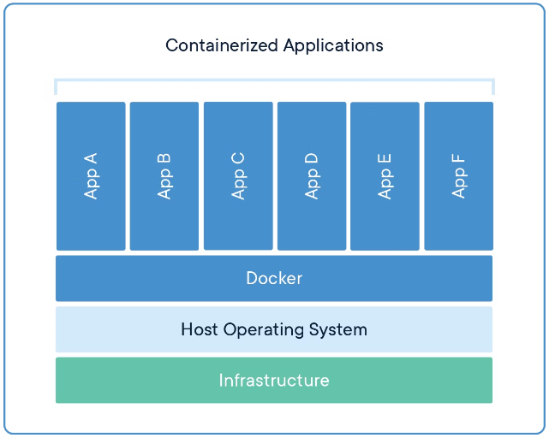
Containerization
Consistent Environment
Easy Deployment
Containerization ensures a consistent and reliable runtime environment for the application.
The containerized application can be easily deployed across different platforms and environments.
Scalability
Portability
Containers allow for efficient scaling of the application to handle increased user demand.
The containerized application can be easily migrated and run on various cloud platforms.

Slide 7


Conclusion
The music recommendation system offers personalized music suggestions through a Python model, an interactive Streamlit interface, and Spotify API integration. It features cross-platform compatibility via Docker and uses a Kaggle dataset. While its accuracy may not rival major platforms like Spotify, it sets a solid foundation for future enhancements.

